Slide 1
Machine Translation of Sanskrit Texts into English
To Dr. Navneet Goyal, Department of Computer Science and Information Systems

Slide 2
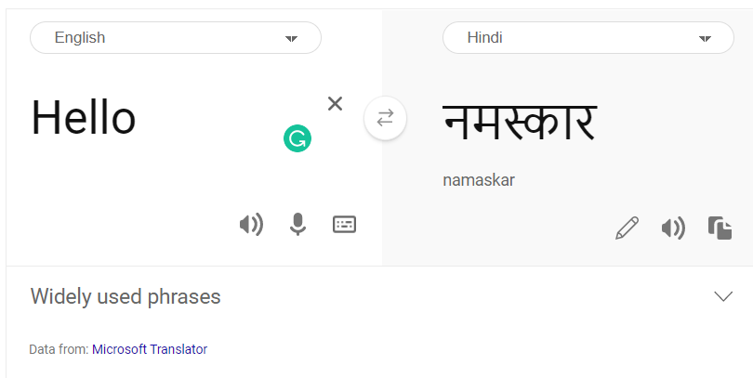
Machine Translation
Transforming text from one language to another by using computer systems automatically or with little human intervention is called Machine Translation Systems (MTS).
Divergence among natural languages in a multilingual environment makes MT a difficult and challenging task.
MT approach used by Google, Amazon, Facebook, and Microsoft is Neural Machine Translation (NMT), which requires a large corpus and high computing systems.
A common machine translator, translating texts from English to Hindi

Slide 3
Approaches of Machine Translation
There are five main approaches of Machine Translation.
Direct Based Machine Translation (DBMT)
Rule Based Machine Translation (RBMT)
Knowledge Based Machine Translation (KBMT)
Corpus Based Machine Translation (CBMT)
Hybrid Based Machine Translation (HBMT)

Slide 4
Direct Based Machine Translation
The procedure involves word by word translation with the help of a bilingual dictionary.
It is followed by syntactic rearrangement of the words.
There is no intermediate representation of codes.
The process is only possible in the case for bilingual translation.
It requires little analysis of text and without parsing.
The process is :-
Source Language text goes through morphological analysis and dictionary look up.
Then the text is re-ordered to produce the Target Language Text.

Slide 5
Rule Based Machine Translation
The intermediate representation of the code may be produced like parse tree.
It relies on rules of morphology, syntax, lexical selection and transfer, semantic analysis, and generation.
It is of two types – Transfer based Machine Translation (TBMT) and Interlingua Based Machine Translation (IBMT)
Interlingua Based Machine Translation
The method uses multiple Source Language Analysers.
They feed there data into a Neural Network, which eventually gives the target language.
Transfer Based Machine Translation
Firstly Semantic and Syntactic Analysis of Source Language Text is done, which produces the format of the source language.
Then transfer methodology is applied, which converts Source Language Format into Target Language format.
Further semantic and syntactic analysis of the format of target language gives the target language text.

Slide 6
Corpus Based Machine Translation
The method requires sentence aligned parallel text for each language pair.
It cant be used for language pairs for which corpora does not exist.
It is of two types – Statistical Machine Translation (SMT) and Example-based Machine Translation (EBMT).
Neural Machine Translation (NMT) is an extension of Statistical Machine Translation (SMT).
Example Based Machine Translation
Firstly source language sentence is analysed.
Simultaneously data of Source to Target Language Example Base is analysed.
The data from both ends are fed into Matcher Module.
The Matcher Module is connected to Source to Target language Example Base, which refines the accuracy of the Matcher Module.
The Matcher Module analyses the data and then synthesize the Target Language Sentence.
Statistical Machine Translation
Firstly the source language sentence is pre-processed.
Simultaneously Monolingual data is used to create the language model.
Bilingual aligned corpus is used to make a translation model.
The pre-processed data, language model, and translation model are fed into the translation mechanism, which gives the Target Language Text.

Slide 7
Knowledge Based Machine Translation
The process requires an extensive knowledge base that includes both ontological and lexical knowledge.
It includes basic AI approaches including semantic parsing, lexical decomposition into semantic networks, and resolving ambiguities.
The process is :-
Firstly Source Language Sentences are analysed.
Simultaneously data of Knowledge Base used to store Extracted Information is analysed.
Both the data is fed into Knowledge Extraction Module.
The Knowledge Extraction Module is connected to the Knowledge Base which refines the accuracy of the Knowledge Extraction Module.
The Knowledge Extraction Module analyses the data and then synthesize the Target Language Sentence.

Slide 8
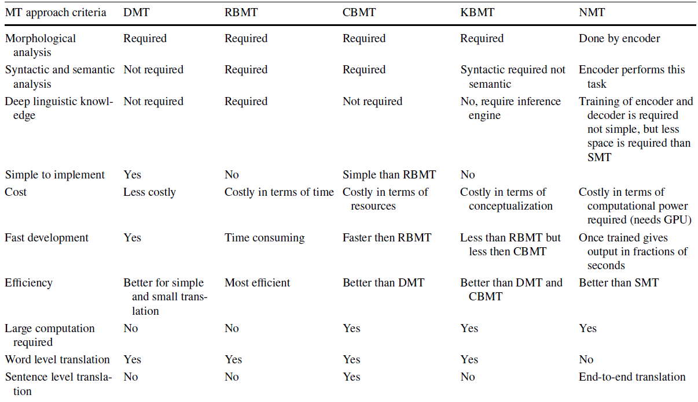

Slide 9
Steps of MT
Machine Translation Systems (MTS) are broadly conducted in two steps
Decoding: Where the meaning of the text is decoded
Re-encoding: Where the decoded text is re-encoded into the target language
The solution which is proposed by the Algorithm is rated on two parameters
Bilingual Evaluation Understudy (BLEU) score
Word Error Rate (WER)
Word Error Rate (WER)
It is used to compute the error rate by comparing machine translated output with the human translated output.
Less the WER is, better the model is.
Bilingual Evaluation Understudy (BLEU) score
It is used for calculating the accuracy of translated sentences compared to the generated reference translations.
It is not good for short translations but it provides accurate results for long sentences.
The higher the BLEU score, the more accurate the model is.

Slide 10
Hardware Required
The following slide discusses the types of hardware required.
The hardware used in one of the papers, analysing CBMT is quoted in the following statements.
Keras Sequential Model is used to process the data.
The model was processed through highly configured core GPU with 32 GB RAM to achieve a high speed of approximately 2500 words per second.
As per the article, the use of highly configured GPU along with NVIDIA Geforce GTX 980 GPU was preferred.

Slide 11
Conclusions
Not much papers are available translating Sanskrit into any language of common use.
The methods of translations used have been tested into other translations, for example English to Hindi Translations.
A huge dataset would be required to make an efficient mechanism which could translate Sanskrit texts into English or any Indian Devanagari Language.
Efficient and sophisticated hardwares and softwares should be used to translate.
Personal Opinion
Vedic texts are written by Srila Veda Vyasa, an advanced personality.
It is said that he has encapsulated immense knowledge in each verse, and each verse of Vedas can be sung in a different meter.
Before starting to translate Vedic texts, other texts should be used and tested.
I recommend using authentic texts for translations.
Some texts which should be considered while forming the corpus are mentioned below.
Bhagavad Gita As It Is
Srimad Bhagavatam
Sri Isopanisad
These texts have been translated by A.C. Bhaktivedanta Swami Prabhupada.

Slide 12
Thank You

